Slide 1
Non- Linear Regression
Data 624 – Predictive Analytics
Gabriel Santos
Anjal Hussan
April 18 - 2023
Notes:
Linear regression is not always the best model for our data, not all data follows a straight line.
Overfitting.
Dimension returns

Slide 2
Regression
A regression is a statistical technique that relates a dependent variable to one or more independent (explanatory) variables. A regression model is able to show whether changes observed in the dependent variable are associated with changes in one or more of the explanatory variables.
Linear and Multiple Regressions are commonly used types of Regression Analysis.
Regression is commonly used in research and data analysis to model and predict relationships between variables.
Notes:
The regression can be linear or nonlinear, depending on whether the relationship between the variables can be approximated by a linear function or not.

Slide 3
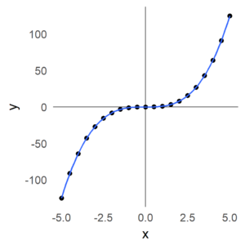
What is Non linear regression?
In nonlinear regression, a nonlinear function is used to model the relationship between the dependent variable and the independent variable(s).
This function can be any mathematical function, such as an exponential, logarithmic, polynomial, trigonometric function, etc.
Notes:
Nonlinear regression is a more complex technique than linear regression, since no closed analytical solution can be found, and therefore the use of numerical methods is required to find the parameters of the nonlinear function that best fit the data.

Slide 4
Linear regression vs. Non-linear regression
In linear regression, the relationship between the dependent variable and the independent variable is modeled by a linear function, such as a line.
Equation for linear regression: y = ax + b + ε
● a = slope ● b=constant ● ε = noise
In nonlinear regression, the relationship between the dependent variable and the independent variable is modeled by a nonlinear function, such as a curve.
Equation for nonlinear regression: y = f(x,β) + ε, where:
● x = a vector of p predictors
● β = a vector of k parameters
● f = a known regression function
● ε = an error term
Notes:
In linear regression: The goal of linear regression is to find the line that best fits the data.
In nonlinear regression: The goal of nonlinear regression is to find the nonlinear function that best fits the data.
This will allow the model to capture the curvature in the scatterplot.
Quadratic model are flexible, since higher order models such x³ can be inserted in the model.
Adding terms may lead to overfitting.

Slide 5
Non-Linear Regression Pros and Cons
Advantages:
They can fit almost any functional form and you don’t need to know the form before training the model
Can model much more complex relationships between the predictors and the outcome than linear models
Disadvantages:
Often not very interpretable
Can be computationally expensive
Some models can be prone to overfitting

Slide 6
Example in R
https://rpubs.com/GabrielSantos/NonLinearRegression
https://rpubs.com/GabrielSantos/NonLinearRegression_residuals
Notes:
Let's see a small example of linear and nonlinear regression
Goal: we want to produce a model that minimizes error
Good for new data.
First we are going to produce a model that fits the data well but not to well for predicting data

Slide 7
Example in R
Notes:
Let's see a small example in Study of linear and nonlinear regression
R Square explains the % of the variance in the independent variable.
Mean square of residual 2.110
F statistics = 52.63 – very high and significance = 6.41E-06 is very small.
The linear model is statistically significant

Slide 8
THE NONLINEAR MODEL
Based off the original scatterplot and even more so the residual plot, it appears that a linear model is not the best choice to model the data
Too much reducible error.
The residual plot shows a definitive curvature.
This indicates that the best model may be non-linear.
Polynomial regression adds extra independent variables that are powers of the original variable: x, x², x³ etc.
Notes:
Adding terms can lead to overfitting

Slide 9
Non-linear Regression Models
There are numerous regression models that are inherently nonlinear in nature, we will focus on following five models:
1. Neural Networks
2. Support Vector Machines (SVMs)
3. Multivariate Adaptive Regression Splines (MARS)
4. K-Nearest Neighbours (KNNs)
5. Computing

Slide 10

Neural Networks
Neurons: Basic unit of neural network also known as node
Layers: A group of neurons. There is one input layer, one output layer, and one or more hidden layers.
Activation Function: Used to introduce non-linearity to model.
Learning Rate: The amount by which weights are changed and is used during backpropagation.
Gradient Descent: It is an optimization algorithm used for finding weights of ML algorithm.
Backpropagation: Training method for feedforward neural networks used by neurons to adapt their weight to acquire new knowledge
Notes:
Neural networks are powerful nonlinear regression techniques inspired by theories about how the brain works. They allow for complex non-linear relationships between the response variable and its predictors.

Slide 11
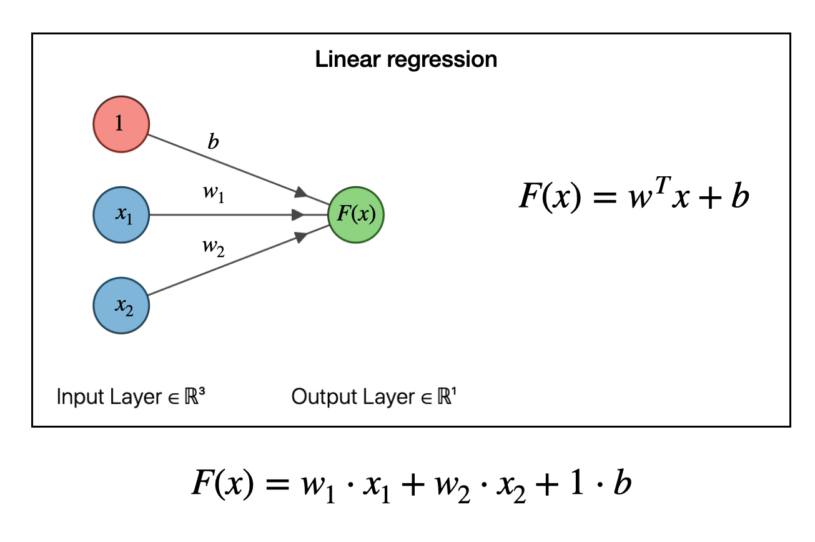
Neural Networks
The simplest neural network contains no
hidden layer and are equivalent to linear regression.
Three inputs in the figure are the
predictors and coefficients attached to
these predictors are called weights.
The forecasts are obtained by linear combination
of inputs.
Retrieve from: https://joshuagoings.com/2020/05/05/neural-network/

Slide 12
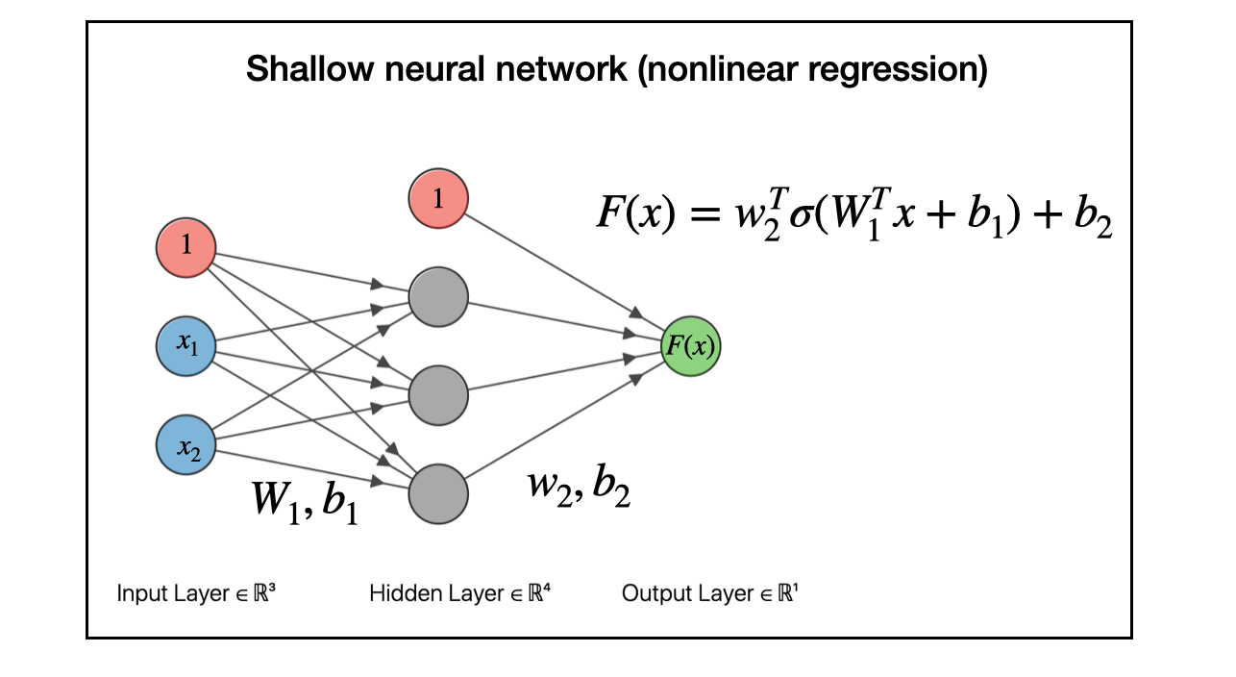
Neural Networks
Once we add an intermediate layer with hidden neurons, the neural network becomes non-linear.
Each layer of nodes receives inputs from the previous layers.
The outputs of the nodes in one layer are inputs to the next layer.
The inputs to each node are
combined using a weighted linear combination.
The result is then modified by a nonlinear function before
being output.
Retrieve from: https://joshuagoings.com/2020/05/05/neural-network/
Notes:
Modern developments of neural networks are much more complicated. I'm simplifying a lot of the details, but the general idea remains: neural networks are models for performing nonlinear regressions, and they are built from linear models. They take one of the workhorses of scientific analysis, linear regression, and generalize it to handle complex, nonlinear relationships between data.

Slide 13
Neural Networks
Advantages:
Robust with noisy data
Disadvantages:
Less interpretable
Need longer training times
Neural Networks have a tendency to over-fit the relationship between predictor and response due the large coefficients

Slide 14
MARS (Multivariate Adaptive Regression Splines)

Slide 15
SVM (Support Vector Machines)

Slide 16
KNN (K-Nearest Neighbors)

Slide 17
Computing

Slide 18
Resources:
Kuhn M. Johson K. Applied Predective Modeling. Springer. 2013

